Slide 1
Customer Lead Prediction Analysis
Insights and Recommendations for Lead Conversion Optimization
Suraj Kashid
MB25

Slide 2
Agenda
Project overview
Data summary
Growth strategy
Summary

Slide 3
Project Overview
Objective: To analyze customer leads and identify patterns that drive conversion.
Key Questions Addressed: Which leads are most likely to convert into paying customers?
How can the platform prioritize and allocate resources to leads with the highest conversion potential?
What marketing and sales strategies can be tailored to specific lead segments?

Slide 4
Data Summary
Data Preparation
Data Cleaning:
Handling Missing Values: Filled missing non-numeric fields with "Unknown" and numeric fields with mean or median values where appropriate.
Data Type Correction: Ensured proper data types for each column (e.g., converting text to numeric where required).
Normalization:
Normalization of Time Variables: Standardized the values for Total Time Spent on the Website to ensure consistent analysis across leads.
Preprocessing:
Removal of Duplicates: Removed duplicate records to maintain data integrity.
Outlier Detection and Handling: Detected and handled outliers in time-related fields to prevent skewed insights.
Creation of Calculated Fields: Added calculated fields such as the Conversion Rate to measure performance across different segments.

Slide 5
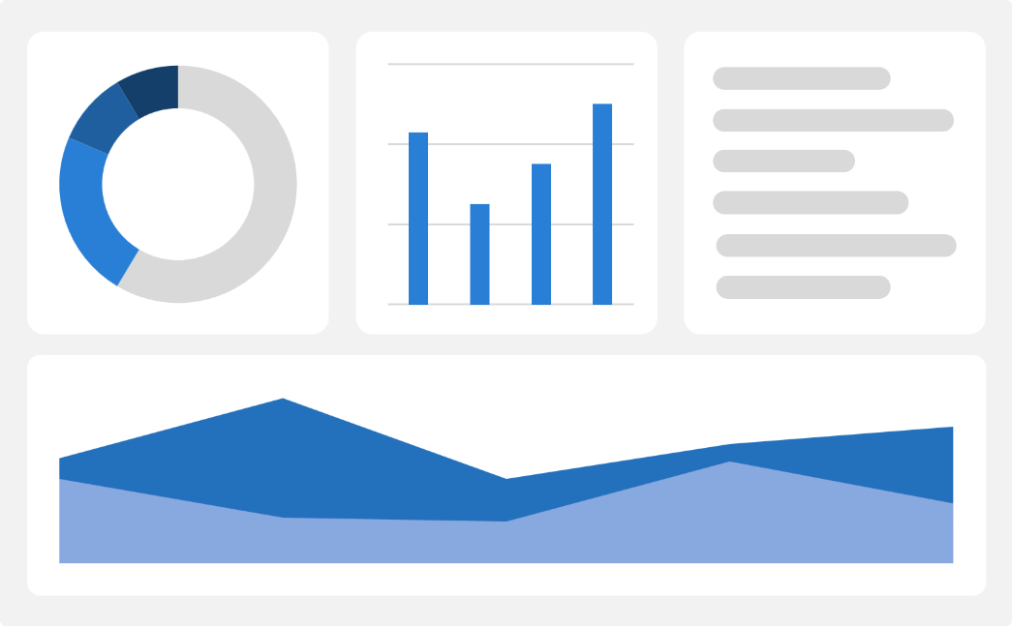
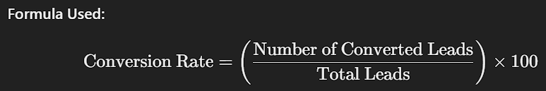
Key Performance Indicators (KPIs)
Total Leads: 9,240
2. Conversion Rate: 39%
3. Average Time Spent on Website: 488 seconds.

Slide 6
Monitoring these KPIs helps track the effectiveness of marketing efforts, sales strategies, and overall lead management processes.
They provide actionable insights that guide resource allocation, strategy adjustments, and targeted marketing campaigns, ultimately driving business growth and improving conversion outcomes.
High lead numbers indicate strong visibility and engagement but need to be analyzed in conjunction with conversion metrics to assess quality.
Helps identify which lead sources and demographics are most likely to convert, enabling targeted improvements in strategy.
Longer time spent suggests that visitors find the website valuable, which could correlate with a higher likelihood of conversion.

Slide 7
Data Analysis and Insights
Lead Source Performance: Google and Direct Traffic are the top lead sources, contributing over 50% of all leads.
Actionable: Optimize marketing on these channels to boost conversions.
Geographical Insights: India and the U.S. lead in generating leads, with Mumbai as the top city.
Actionable: Tailor campaigns to target these high-potential regions.
Website Engagement: Average time spent is 488 seconds, indicating strong engagement.
Actionable: Improve website experience to further increase user interaction and conversions.

Slide 8
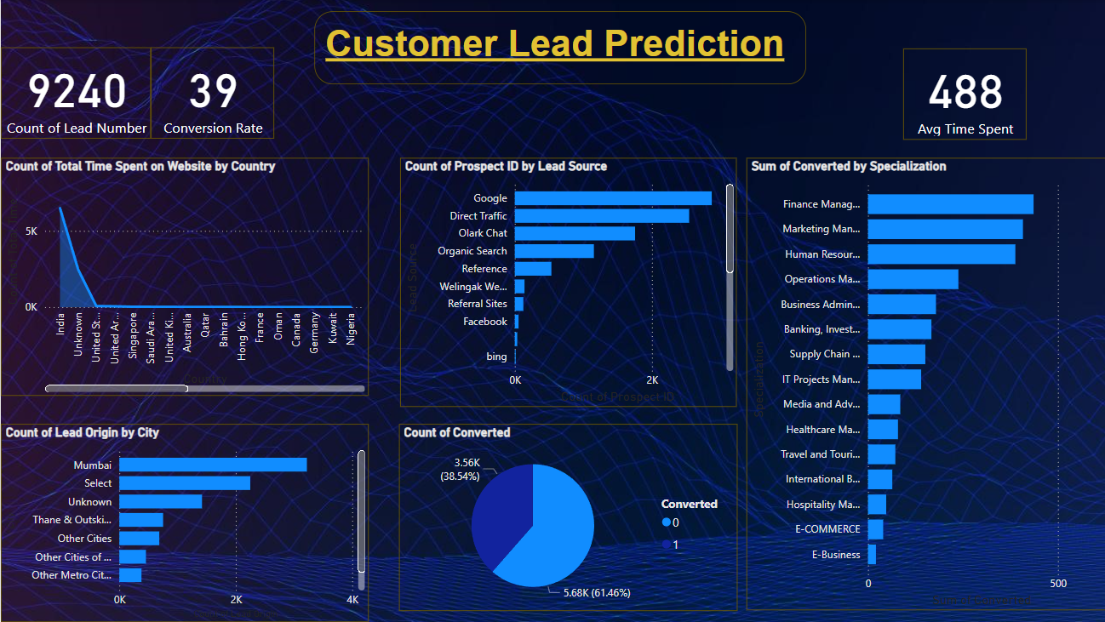

Visuals and Dashboard Walkthrough

Slide 9
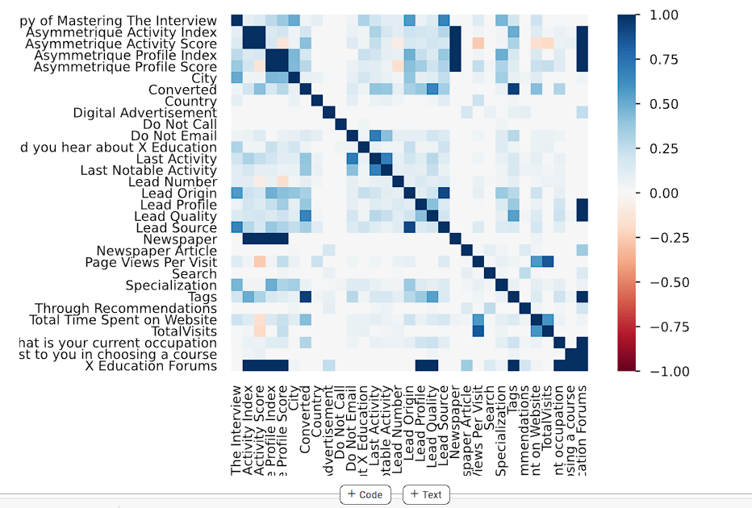
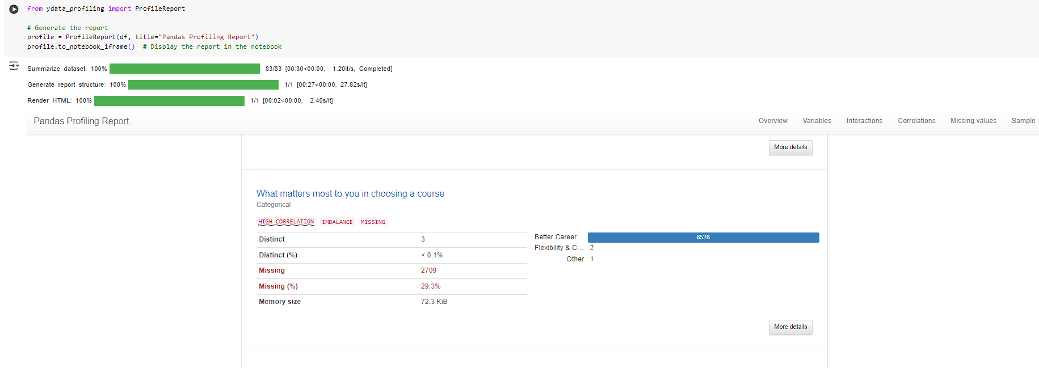
Expand
Foster collaborative growth
Enhance
Ensure a tailored and user-focused experience
Explore
Capitalize on emerging global markets
Expand market reach through strategic partnerships
Enhance product features based on user feedback
Explore international market opportunities

Slide 10
Recommendations and Action Plan
1. Prioritizing Lead Sources:
Focus resources on high-performing channels like Google and Direct Traffic.
Action: Increase ad spend and optimize content for these platforms.
2.Improving Conversion Rates:
Strategies: Implement personalized follow-ups, targeted marketing, and enhance website UX.
Action: Use data-driven campaigns to engage leads more effectively.
3.Enhancing Engagement:
Analyze traffic to identify high-engagement areas.
Action: Replicate successful website elements to maintain and boost user interaction.

Slide 11
Conclusion
Summary of Key Findings:
Google and Direct Traffic are top lead sources, with India and the U.S. leading in lead generation.
Conversion rate stands at 39%, with potential for improvement through targeted efforts.
Impact of Data-Driven Decisions:
Leveraging insights helps prioritize high-performing channels, optimize resources, and refine marketing strategies for better outcomes.
Final Thoughts:
Continuously analyzing data is crucial for enhancing lead conversion and staying competitive.
Data-driven strategies empower better decision-making and improve overall performance.

Slide 12

Thank you

